Slide 1
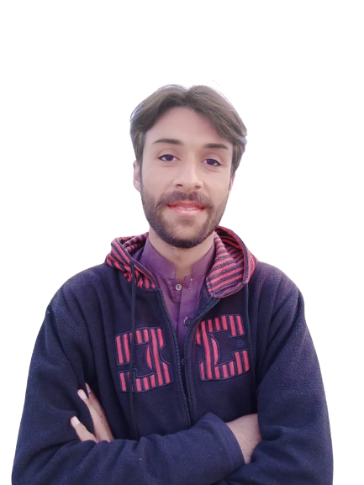
Complex Task Series
Problem Number 87

Slide 2
Problem Statement
Create a Desktop Application in Python that displays a dialog asking the user to enter his / her name and age and display name with age in console. Hi NAME! Your age is AGE

Slide 3
Algorithm
Step1: Import required library
Step2: Create a Basic Window
Step3: Set geometry for that window
Step4: Get name / age from user using simpledialog
Step5: Display the result to user
END

Slide 4
Algorithm
from tkinter import simpledialog
from tkinter import * application_window = Tk()
answer = simpledialog.askstring("Input", "What is your first name?",parent=application_window)
if answer is not None:
print("Your name is ", answer)
else:
print("You don't have a first name?")
answer = simpledialog.askinteger("Input", "What is your age?",parent=application_window)
if answer is not None:
print("Your age is ", answer)
else:
print("You don't have a age?")
application_window.mainloop()

Slide 5
Assignment
Create a Desktop Application in Python that displays a dialog asking the user to enter his / her name and age and display name with age in window. Hi NAME! Your age is AGE

